Slide 1
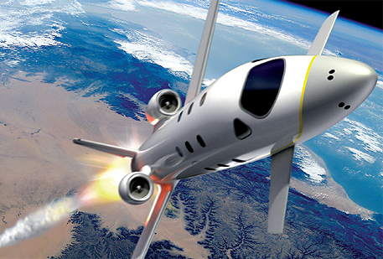

FDIR Spacecraft fault protection system
Project 1
Part 2
Euro Team
Alauzet Pierre, Ahvenniemi Mikko,
Colin Julien, Starck Benoit
CS554 - Design for Software & Systems

Slide 2
Table of ContentS
Domains identification
Requirements
Context diagram
Problem diagram
Problem frames

Slide 3
FDIR Spacecraft fault protection system
Project 1
Part 2
Euro Team
Alauzet Pierre, Ahvenniemi Mikko,
Colin Julien, Starck Benoit
CS554 - Design for Software & Systems

Slide 4
references
[Eas98] Steve Easterbrook, and et al., “Experiences Using Lightweight Formal Methods for Requirements Modeling,” IEEE Transactions on Software Engineering, Vol. 24, No. 1, January 1998.

